Slide 1




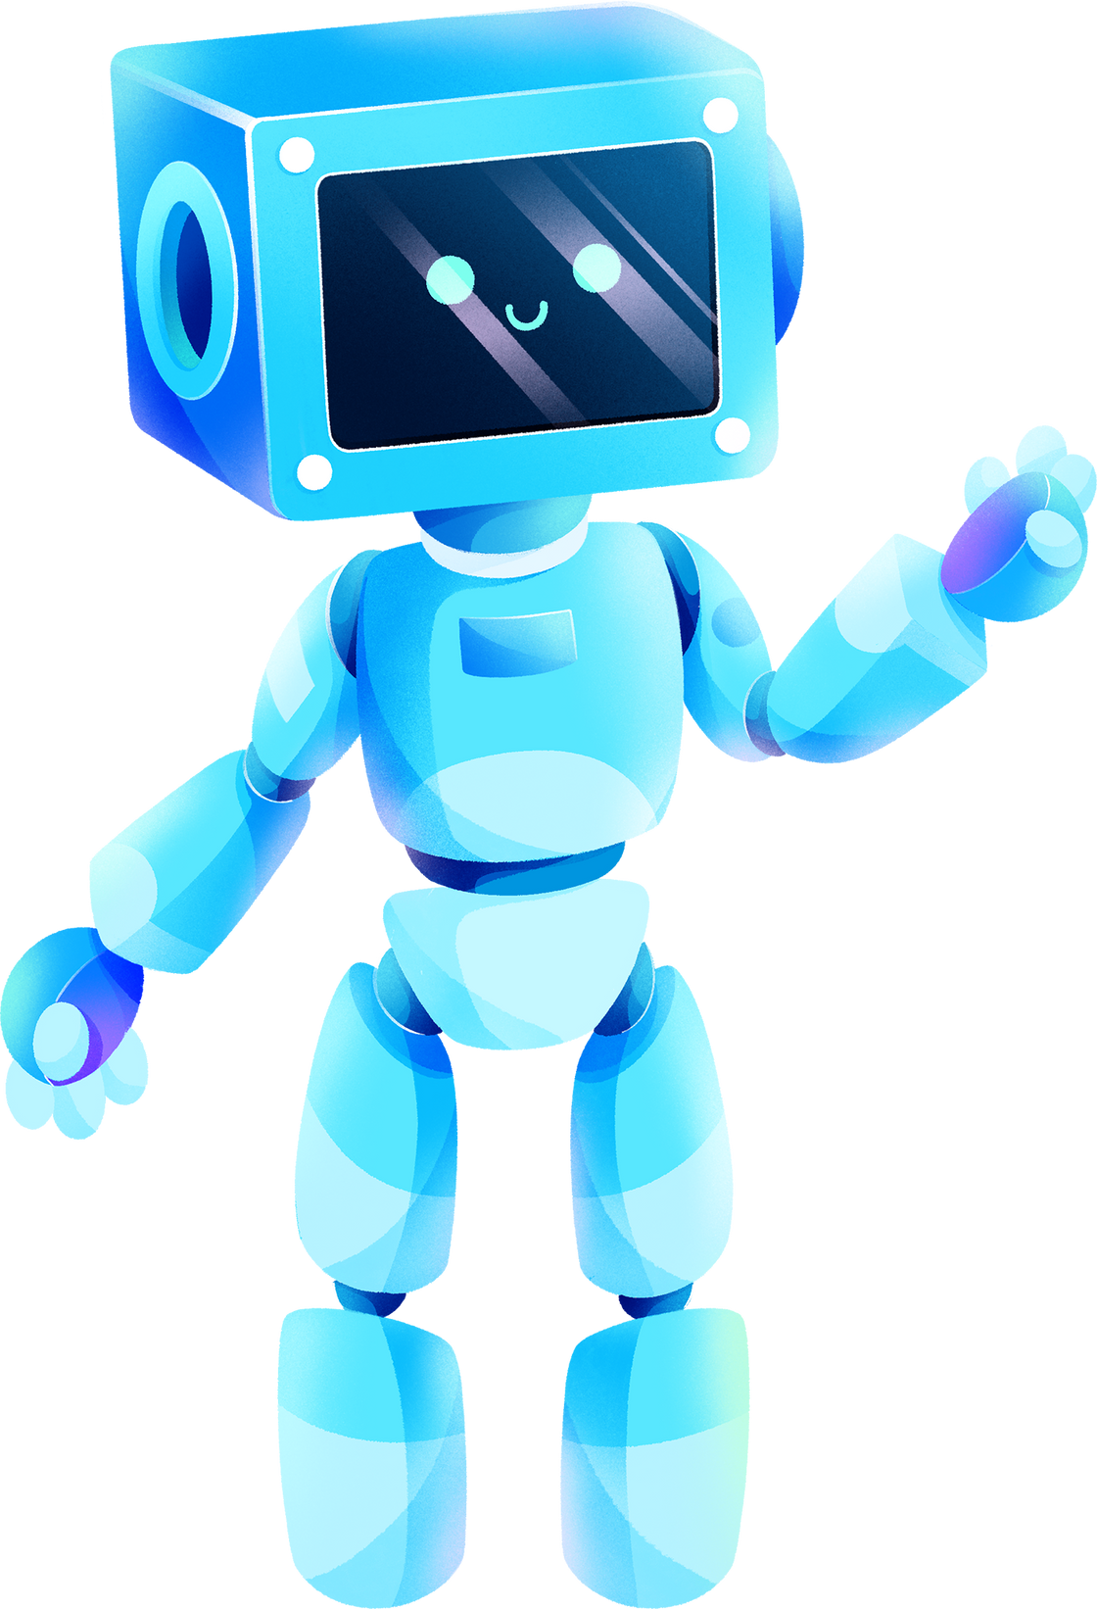

ARTIFICIAL INTELLIGENCE
PROJECT
By Team: Pooja Nair

Slide 2
TABLE OF CONTENTS
Introduction
Our Objective
Impact
Our Vision
Conclusion
FAQ
Q&A
03
04
05
06
07
08
09

Slide 3

INTRODUCTION
Are you a student who’s currently thinking of the career path they want to take when they graduate? Is your graduation coming up soon? Don’t know where to start looking? Fear not! We are here to introduce to you our newest invention: PathFinder1.0: Your very own career compass!

Slide 4

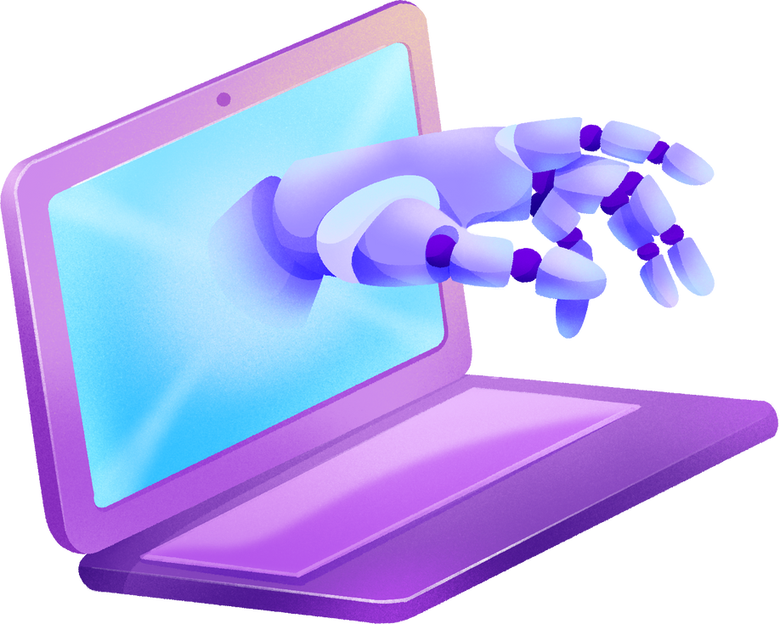
OUR OBJECTIVE
With PathFinder1.0, we are hoping to make sure all students are able to find a suitable career path for them to take in the future so that they can unlock their full potential and show everyone else that they are exceptional at what they do. PathFinder1.0 was designed by us with the help of OpenAI to give students suggestions on appropriate career paths and job opportunities based on information given by the student, such as: Preferred hobbies, special interests and specific skill sets that they know they are exceptional in.

Slide 5

IMPACT
01
02
03
04
Personalized Guidance: PathFinder1.0 offers career guidance based on individual interests, hobbies, and skill sets. By providing personalized recommendations, it helps students discover career paths that align with their unique strengths and passions, increasing the likelihood of long-term satisfaction and success.
Accessibility and Convenience: With PathFinder1.0, students can access career guidance anytime, anywhere, through their devices. This accessibility ensures that individuals can explore their career options at their own pace and convenience, without the constraints of traditional counseling services.
Objective Insights: PathFinder1.0 utilizes algorithms to analyze data, offering objective insights into various career fields and industries. By presenting unbiased information, it helps students make well-informed decisions about their future, minimizing the risk of choosing a career path that may not be suitable for them.
Cost-Effective Solution: Utilizing PathFinder1.0 for career guidance can be a cost-effective alternative to traditional counseling services or career assessment programs. With its accessible and scalable platform, PathFinder1.0 offers valuable guidance for no fee whatsoever, making it an affordable option for students from various educational backgrounds to access quality career exploration resources.

Slide 6







OUR VISION
1.
2.
3.
Make sure students don’t face any issues when deciding their the paths they want to take down the line, and to ensure students don’t feel left out or uncomfortable in the fields they want to work in.
Provide an affordable program that can be accessed by students and teachers alike with the intention of making it easier for students to choose their career paths, additionally we want to provide a space that will help academic advisors interact and cooperate with any students they are working with.
We are hoping in future to expand PathFinder1.0 to make it more efficient and effective, while also adding more customizable features that appeal to each student’s needs, moreover we would like to expand the platform to make it interactive for any teachers also using the program.

Slide 7


CONCLUSION
With all that said, PathFinder1.0 is a revolutionary piece of technology that we hope in future will be used by students and teachers and guide them in their academic journeys, and we hope to keep making PathFinder1.0 better to hopefully appeal to everyone.

Slide 8




FAQ
How will PathFinder1.0 appeal to all students and not give generic recommendations?
Since students will be inputting their own hobbies and interests and skill sets, the recommendations given will be directly aimed towards them and will consist of job opportunities that join their skills and hobbies together.
01
Can it be used by teachers as well?
Yes of course, teachers can be seated with their disciples and make sure that any information given by PathFinder1.0 to the students is understood by them. The people who can make the most use of PathFinder1.0 are academic advisors who now have an interactive platform to present to students.
02

Slide 9






ANY QUESTIONS?

Slide 10
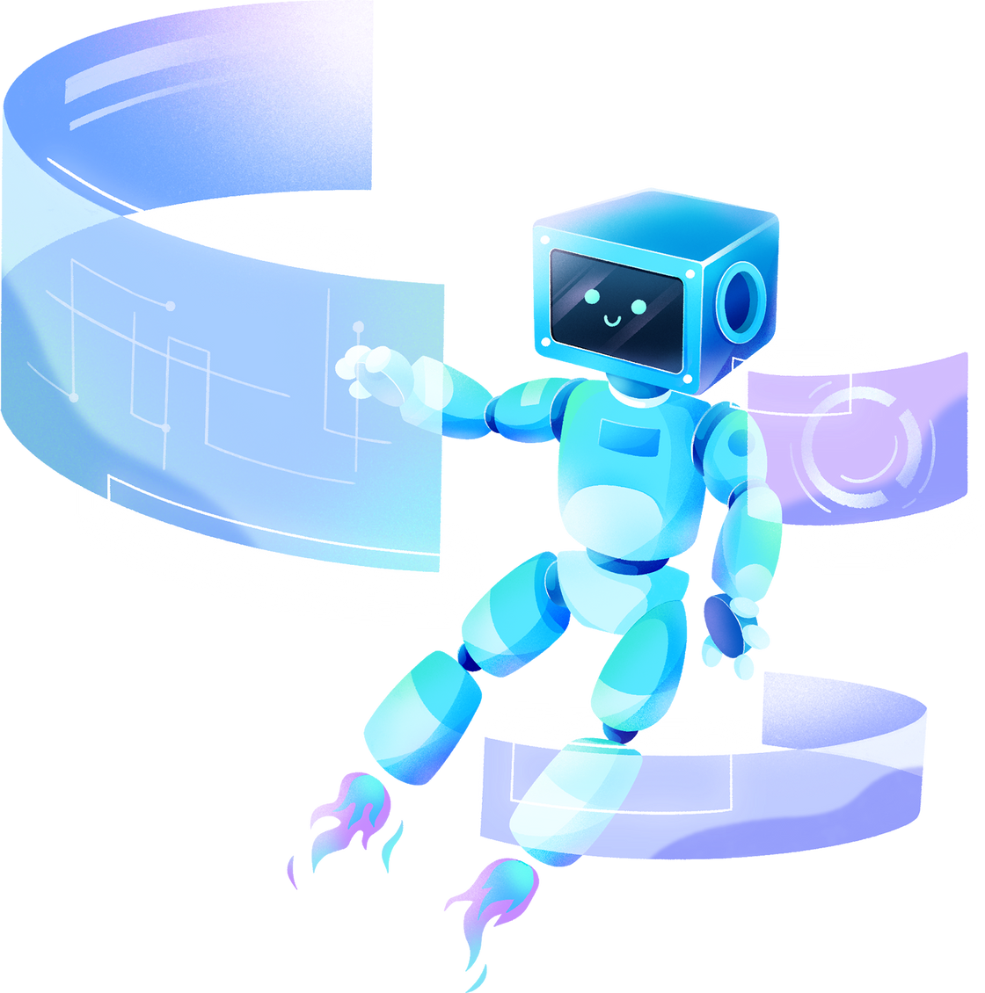
THANK YOU FOR LISTENING!

